Slide 1
Unit 4:
Case studies on preparedness and response for a nuclear emergency
Name of Lecturer
Organization
Email address

Slide 2
Learning objectives
To provide an opportunity for the course participants to practice the knowledge gained during the BPTC and the use of IAEA Safety Standards and associated guidance on EPR
The practical session is not intended to test response arrangements in specific organizations or to evaluate the performance of individual participants

Slide 3
Contents
Case study 1 on “Roles and responsibilities”
Case study 2 on “Protective actions and exposure pathways”
Case study 3 on “Concept of operations for a nuclear emergency at a EPC I facility”

Slide 4
Instructions for organization
The participants should work in groups (3 to 4 groups preferably); when more than one participant per country, they should work in different groups
Logistics to be provided by organizers:
  Video projector
  Access to Internet for participants to download (if needed) the BPTC Book and IAEA safety standards and other technical documents on EPR
  The PDF version (hard copy and/or electronic) of this presentation!
Notes:
Important:
Please be aware that the ppt version of this presentation include Notes with explanatory information on solving the tasks!
Therefore, for the purpose of learning, the participants should be delivered the pdf version of this presentation.

Slide 5
Instructions for participants
Participants may bring their laptops to access the electronic version of the BPTC Book and the relevant IAEA publications on EPR
Interactive discussions within the group are encouraged
Each group to delegate a spokesperson to present the group’s solutions for the tasks, during the common discussions

Slide 6
Instructions for conducting the practical session
Total duration: 90 minutes
Preparation: 5 minutes, for the organization in groups
Case study 1: 10 minutes for answering + 10 minutes for common discussions (all together), followed by
Case study 2: 10 minutes for answering + 10 minutes for common discussions (all together), followed by
Case study 3: 30 minutes for answering + 15 minutes for common discussions (all together)

Slide 7
Case study 1: Roles and responsibilities
Determine level of responsibility (operator, off-site, international):
  Protect people on-site
  Notify IAEA
  Provide radiological monitoring
  Implement protective actions off-site
  Provide support to the facility
  Public communication
  Provide medical treatment
  Notify and exchange official information among international community
  Coordinate the inter-agency response
  Notify and keep off-site authorities informed
  Provide advice and assistance, if requested
  Perform assessment and prognosis
  Mitigate the emergency
Time to answer: 10 minutes
Time for discussion: 10 minutes
Notes:
Objective
- To make a recap of key response functions and roles and responsibilities of main stakeholders (operators of EPC I facility, off-site officials and international organizations)
NOTES
- Some activities, such as public information, may be covered by more than one organization
- The list is taken from the text book of Module 16, Chapter 4, Table 4.2

Slide 8
Case study 2:
Protective actions and exposure pathways
Which protective action(s) protect against:
Cloud shine
Ground shine
Inhalation
Ingestion
Inadvertent ingestion
Skin contamination
Time to answer: 10 minutes
Time for discussion: 10 minutes
Notes:
Objectives
- To recap the protective actions
- To make connection between protective actions and related exposure pathways

Slide 9
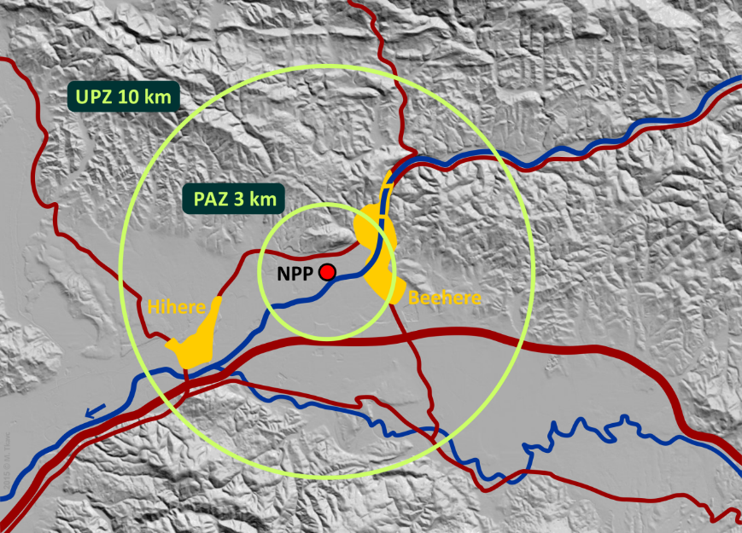
Case study 3:
Concept of operations for a EPC I facility
Background information
The Blue NPP is a 1000 MWe PWR,
commissioned in the 1980s
It is located in Neverland,
near the town of Beehere
Emergency planning zones
and population: see table
No early warning system
PAZ | 3 km | 10.000
UPZ | 10 km | 40.000
EPD | 25 km | 100.000
ICPD | 250 km | 2 M
Task 1
Are sizes of the planning zones in line with the IAEA recommendation? Possible reasons for not being in line? Any examples you know?
Explain early warning system (EWS) and its purpose
Time to answer: 30 minutes
Time for discussion: 15 minutes
Notes:
Case study 3 consists of a series of sub cases
- After introductory slide, they can be used separately
Instruction Points
- Imaginary situation
- An average Gen II NPP
- Describe the map to provide background information
- NPP on the river
- Two towns
- A highway and some local roads
- Flat terrain and hills to the north and south
Instruction Points
- Are sizes of the planning zones in line with the IAEA recommendation? Possible reasons for not being in line? Any real world examples?
- Explain early warning system (EWS) and its purpose
NOTES
- Population number is cumulative, e.g. UPZ = PAZ + 30.000

Slide 10
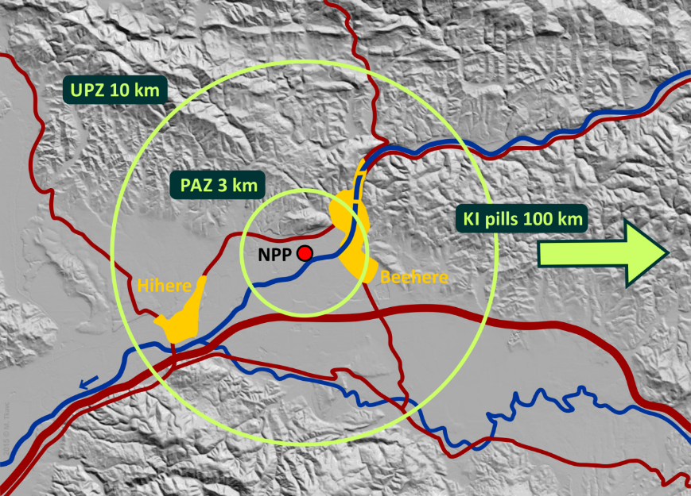
Case study 3:
Concept of operations for a EPC I facility – cont’d
Challenges in ITB arrangements
For ITB there is a national stockpile of stable iodine pills located 100 km away
There is no operational plan for distribution of the pills
Task 2
Identify challenges authorities would face when implementing ITB
Notes:
Instruction Points
- Repeat basics of ITB - Ask participants
- Time is crucial for ITB to be effective
- Shortly before exposure or as soon after as possible
- Iodine uptake is blocked by 50% even after a delay of several hours
- Make an estimation of time needed to implement ITB in this case
- Conclusion: Pre-distribution is needed or at least stockpiles on location
NOTES
- KI = Potassium Iodide, chemical compound of iodine pills for ITB

Slide 11
Case study 3:
Concept of operations for a EPC I facility – cont’d
Challenges in evacuation
Evacuation plan not updated, no duration estimate
Evacuation to be carried out by private vehicles
The town of Beehere is split by the river, with only two bridges
Protection strategy: in general emergency evacuation is to be performed; evacuate PAZ; evacuate UPZ, after completing PAZ; no evacuation is planned outside PAZ
Task 3
Identify evacuation routes and challenges when implementing evacuation
Notes:
Instruction Points
- Repeat basics of evacuation - Ask participants
- Organized evacuation is crucial for safety and timeliness
- Evacuation plan
- Clear instructions what to do, where to go
- Arrangements in place for reaching out to people with instructions
- Information material provided in advance in preparedness phase
- Evacuation routes signposted in advance in preparedness phase
- Possible evacuation routes in this case?
- The river - good or bad? (+ divides the town, physically dictates evacuation routes, - traffic jam on the bridges, if they are not controlled)
- How far should reception points be?
- Make an estimation of time needed to implement evacuation in this case
- Conclusion: Plan is needed, including duration estimate
NOTES
Protection strategy used by Neverland:
- Evacuation when General emergency
-> Evacuate PAZ
-> Evacuate UPZ, after completing PAZ
- No evacuation is planned outside PAZ

Slide 12

Case study 3:
Concept of operations for a EPC I facility – cont’d
General emergency
An event and the Blue NPP declares General Emergency
At 07:45 hours, working day, no release detected/reported yet
Task 4
Outline major actions by the NPP and off-site authorities
Challenges?
Notes:
Instruction Points
- Repeat concept of operations - Ask participants, refer to the Module 16 textbook, Chapter 4.3
- This can be as detail as time permits
- Make sure to cover at least
- Notification to off-site
- Off-site activation
- Ordering evacuation within PAZ + giving instructions
- Public communication
- Closing-off the area (transportation …), etc.
- Challenges?
- It is early in the morning on a working day!
- Off-site authorities are reluctant to order evacuation (release is not expected), violating the plan

Slide 13
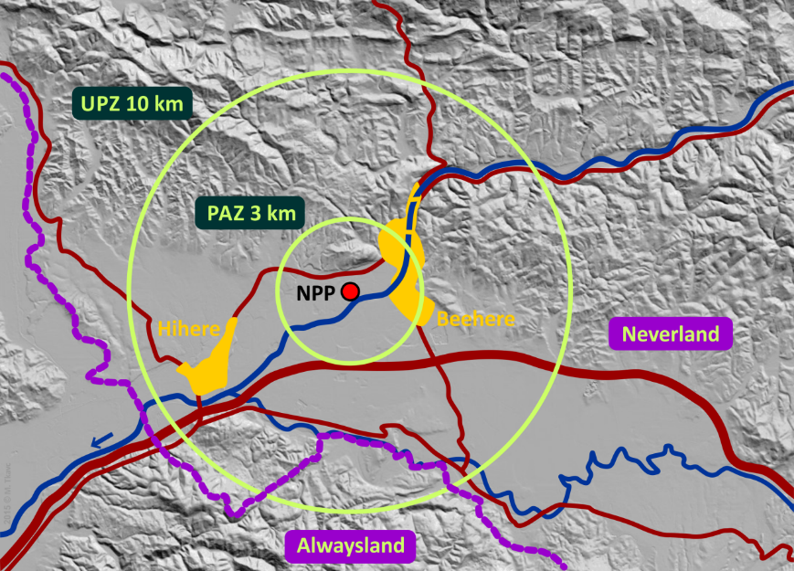
Case study 3:
Concept of operations for a EPC I facility – cont’d
NPP is close to the national border
Imagine now that the NPP is located at approx. 5 km distance to the national border (see picture)
Task 5
What does this change?
Challenges?
Notes:
Instruction Points
- Point our that such situation is surprisingly common (EPC V!)
- Notifying neighbouring country
- Sharing event status data
- Harmonization of implemented protective actions across the border
- Harmonization of arrangements in preparedness stage – bilateral agreements
- Evacuation routes of Neverland
NOTES
- Refer to the Convention on Early Notification of a Nuclear Accident

Slide 14
References
BPTC Text Book
Presentations Module 16 (Unit 1, Unit 2 and Unit 3)
GSR Part 7
GS-G-2.1
EPR-NPP Public Protective Actions 2013
EPR-METHOD 2003

Slide 15
Thank you and good luck!
Notes:
Thank you!

